Slide 1
Airlines Industry
Presented by:
Alisha Anand (2)
Chandni Goyal (5)
Rasika Kumbhar (11)
Priya Sharma (14)
Vithika Singh (20)

Slide 2
Agenda
01
Airlines Industry Introduction
05
Customer Journey Mapping
02
Emirates Airlines
06
Identified Gaps
03
Indigo Airlines
07
Recommendations
04
Voice Of Customers

Slide 3
Airlines Industry
The airline industry encompasses a wide range of businesses, called airlines, which offer air transport services for paying customers or business partners. These air transport services are provided for both human travellers and cargo, and are most commonly offered via jets, although some airlines also use helicopters.
As a rule of thumb, acquiring a new customer costs around five times as much as winning business from people who've bought from you before. Customer relationship management (CRM) platforms are an invaluable tool for optimising customer retention, in the process enhancing margins, reducing costs and extending customer lifetime value.
Notes:
​Consider an airline which remembers the customer's name and past purchases, that can offer personalized deals and which uses a range of technologies to respond to customer enquiries. Compare that to a ‘standard’ airline which shows no apparent interest in the individual customer, and simply sells them the same service each time at the same price.

Slide 4
Customer relationship management is important in any sector. However, in the highly competitive airline industry, this technology is even more essential. Since air travel is becoming increasingly commoditized, passengers are less likely to be loyal than in the past. Nevertheless, customers do consider the service they get from different airlines when making purchasing decisions, and CRM in aviation is therefore very important when it comes to making your airline stand out from the crowd.
Some of the advantages of CRM in airline industry are given below
Process Automation
Enhanced Control across all departments
Data Security
Notes:
https://www.conztanz.com/why-improve-customer-relationship-management-in-the-airline-industry/
https://www.techloyce.com/customer-relationship-management-in-airline-industry/
Enhanced Control across all Departments
There are a number of costs that incur from operations across every department. These usually take the form of material costs, labor costs and operations management. It is important to thoroughly examine all the departments before arriving at any decision. CRM for aviation helps in providing a bird’s- eye view of all the operations across different sectors. This helps to identify any shortcomings and rectify them quickly. CRM is a dynamic software that improves the overall visibility and since it is compatible with a wide range of portable devices, this adds to its functionality factor.
Data Security
In the aviation sector, it is highly imperative that the data remains confidential and secure. CRM software for aviation industry is designed to give users a high level of trustworthiness. There are tools which give certain users the permission to view company’s data. Further, other benefits that can be taken advantage of are ease with which maintenance can be performed, use of a single data protection mechanism for the entire data environment and detect impending threat on the basis of relative changes. With the use of CRM, aviation industry is able to streamline all its activities and provide best customer service.
Process Automation
The overall goal of the aviation sector is to cut down on irrelevant steps and improve productivity. CRM software automates the entire process which facilitates to control key business functions such as cost, operation and maintenance. The constant changes in configuration are easily dealt with and it doesn’t require a dedicated system to achieve each mission successfully.

Slide 5
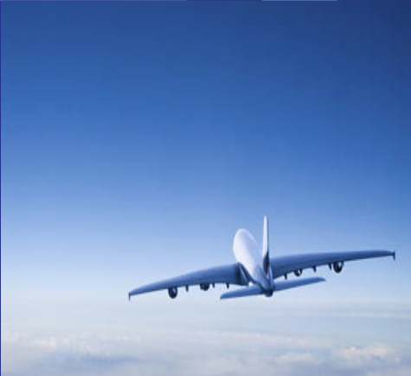
Reservations
Baggage tracking
Check in & check out
Touch points
Food & Beverages
Frequent flyer program
Flight attendants
Business class services

Slide 6

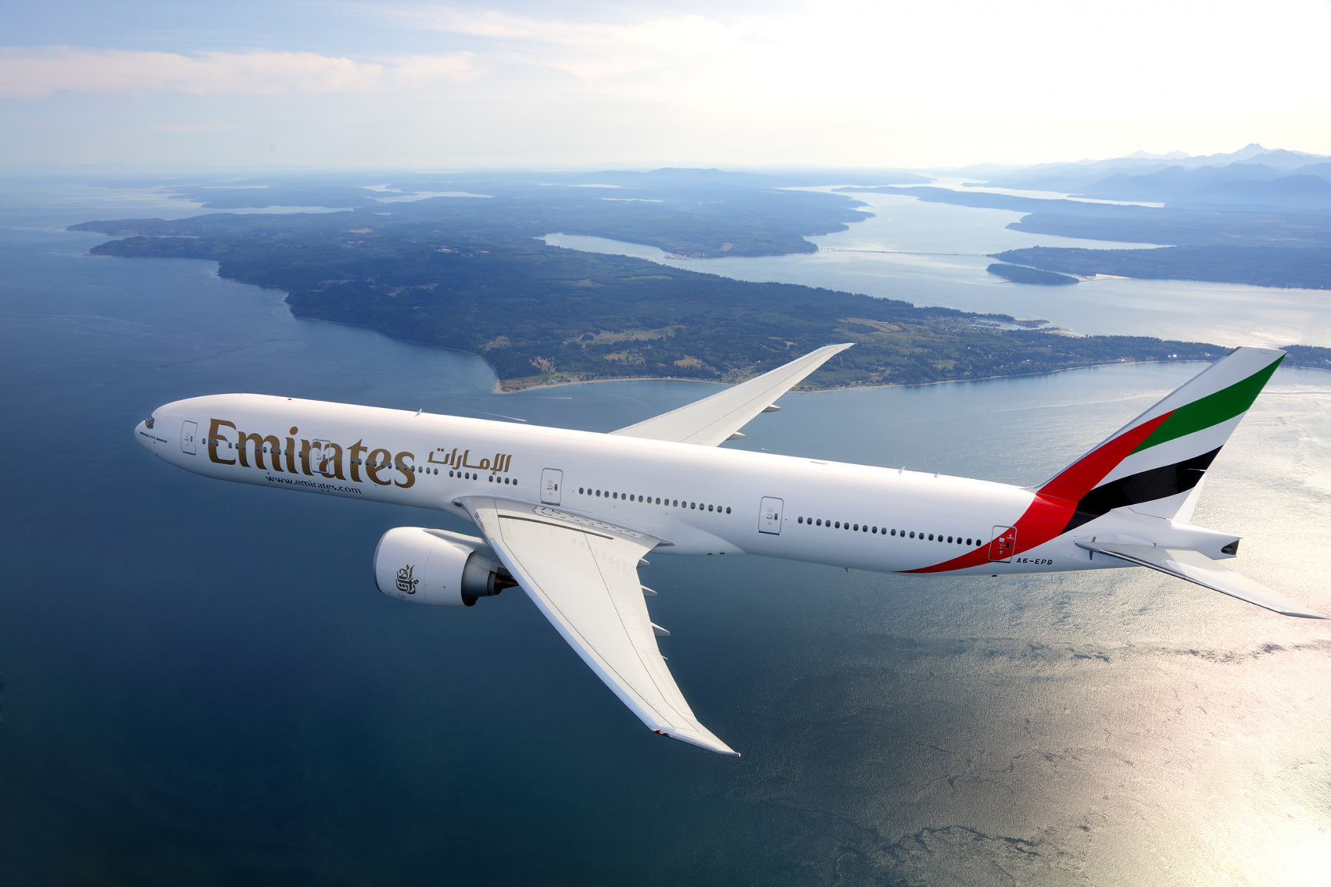
Emirates Airlines
Emirates is the largest airline of the United Arab Emirates. The airline is a subsidiary of The Emirates Group, which is owned by the government of Dubai's Investment Corporation of Dubai.
Emirates is the world's fourth largest airline by scheduled revenue passenger-kilometers flown, and the second-largest in terms of freight tonne kilometers flown.
It is also the largest airline in the Middle East, operating over 3,600 flights per week from its hub at Terminal 3 of Dubai International Airport, to more than 150 cities in 80 countries across six continents through its fleet of nearly 300 aircraft.
Notes:
Emirates, the world's third-largest airline by scheduled revenue passenger-kilometers flown and number of international passengers carried was founded in 1985 by the royal family of Dubai. The airline's first flight was from Dubai to Karachi, Pakistan in October of that year.

Slide 7
CRM services of Emirates
Emirates started using a CRM strategy in 2000.
Windows 8 - based CRM application: Emirates airline was the first company in the Middle East to use CRM software, Knowledge-driven In flight Service (KIS).
Emirates provided 1000 pursers with HP tablets as part of Knowledge-driven In-flight Service (KIS).
Moreover, the gathered data support Emirates in segmentation and targeting because they can analyze very specific information about customers’ expectations.
Pursers use KIS to brief the cabin crew before every flight and check passenger’s special needs, as well as see who is enrolled in Emirates’ frequent flyer program Skywards.
Cabin crew can also use the KIS system to perform in-flight upgrades to Business or First Class, as well as post customer feedback that is emailed to headquarters upon landing.
Notes:
https://www.slideshare.net/shubhravc/customer-relationship-management-of-emirates
Explain:
1.It allows the airline’s cabin crew to see which previous trips a passenger has taken with the carrier and based on this, knows their food, wine, and seating preferences, or any issues a customer had during their travels.

Slide 8
Contd.
It offers membership in two types of loyalty programs: Emirates Skywards and Business Rewards.
It is the award-winning FFP launched in May 2000.
Earn Miles and spend Miles with Emirates and wide selection of partners
Miles Calculated using:route,Fare type,class and tier
01
Skywards
02
It is a Loyalty program which is open to small and medium-sized enterprises (SMEs) around the world.
Organizations earn miles on flights taken by employees
Business Rewards
03
It is also one frequent flyer program for young travellers aged two to 16.
They can collect Miles for treat like free flights, Apple iPods, games and latest fashion accessories.
Skysurfers
Notes:
Skywards:
Membership in Skywards gives the traveler or customer the chance to earn and spend accumulated Miles with Emirates and a wide selection of partners and enhances their travel experience with benefits and services that make every trip more rewarding.
Skywards Miles are calculated using four basic inputs: route, fare type, class, and tier.

Slide 9
Contd.
There is Emirates High Street collection, which can bring you most extraordinary and rewarding shopping experience with a huge range of luxury goods, a catalogue with over 150 pages that you can order during flight or at home.
There is ‘Travel Planner’ as well through which you can update your seats, meals and drink preferences. It assist you personally, on what you need and what you want.

Slide 10
Other CRM implementations
E-Services tools
E-Claims
E-Services guide tour
E-Newsletter
Extra Airline benefits
Special meals
Chauffeur drive
Fast track
Dubai visa service
Stopover service
Hotel booking functionality
Unaccompanied young passengers
Notes:
Fast track checking and priority baggage claims

Slide 11
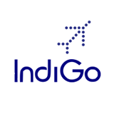
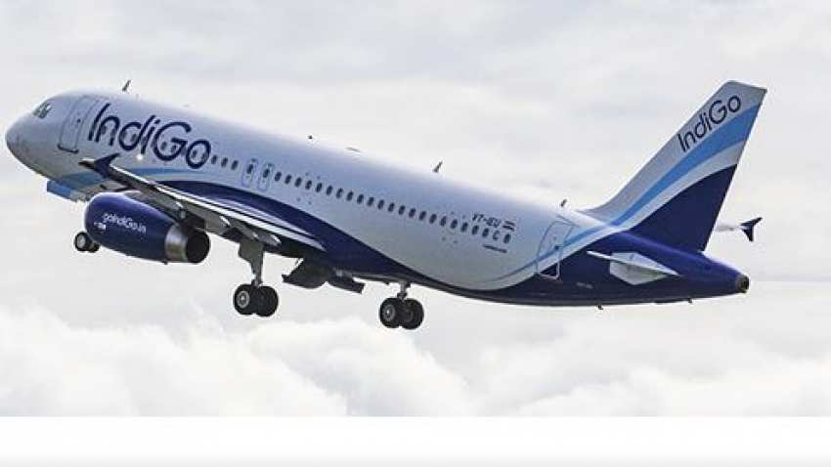
Indigo Airlines
IndiGo commenced operations on 4 August 2006. Zoomtra.com is an authorized partner of Indigo Airlines. Primarily operate in India’s domestic air travel market as a low-cost carrier. IndiGo is India’s largest passenger airline with a market share of 60.4% as of July, 2020. Fleet of 275 aircraft today serving 22 cities within India with 188 daily flights.
Indigo
On-time
Affordable price
Hassle free

Slide 12
CRM services of Indigo
6C membership Scheme: This is a scheme for those customers of IndiGo airlines who are consistent flyers of IndiGo airlines. These customers are provided membership into 6C membership scheme, which help them avail 10% discount on base rate of their tickets.
IndiGo Corporate plan: This plan is for those corporate travelers who prefer travelling with Indigo airlines for their corporate visits. In this plan a contract is entered into with the corporate and this is an annual contract which provides some concessional benefits to those corporate.
Partial Payment Schemes: Those customers who have their account in Citibank and HDFC banks can make partial payment of tickets and pay the remaining amount later, or the remaining amount can be paid in EMIs. In this case banks become intermediaries and airlines develop good relations with both the customers and banks

Slide 13
Contd.
FAM trips: Special trips to tourist destination in partnership with trip planning sites. These trips are different from the packages that are provided by the airlines. These are specially trips planned for those customers who hold account in indigo airlines. These trips can be availed by all kind of account holders.
Value flier & bundled hotel offerings: Leisure travelers are provided with a ticket package called value flier & bundled hotel offerings. Those customers who are willing to pay some extra amount and get a package for their travel can avail this plan. Through this plan they can pay some more amounts and can get free food on board or the package can also provide hotel offerings.
Separate accounts for member, agency and corporate: Indigo airlines provide different accounts for member, agency and corporate and they are provided schemes according to their needs and nature of account specifies different facilities that can be availed by virtue of holding that account.

Slide 14
Contd.
IndiGo Plus: IndiGo offers a premium service called IndiGo Plus, where the passengers, at a higher fare, can avail additional benefits like a pre-assigned seat and a complimentary meal on board. This is available to those customers who book their tickets 2-3 months before the scheduled time through internet.
Citizen charter section: This is customer care center of Indigo airlines where customer’s queries are answered. In this facility there is faster response from the center and the phone is directly picked by the associate and there is no need to wait while the machine answers.

Slide 15
Extra Indigo benefits
Online reservation system
Separate accounts for member, agency and corporate
24/7 multilingual call centre
Proper schedule available on the website
Baggage Tracer,Food and Beverages are allowed inside the flight.
Refund is available in case the flight is delayed by more than two hours providing a safe and on-time service.
CRS system for reservation providing a safe and on-time service. Increasing ancillary revenues .
For leisure travellers, it offers a ticket package called Value Flier & bundled hotel offerings.
Notes:
http://docshare01.docshare.tips/files/17649/176493578.pdf

Slide 16
Voice of customers

Slide 17
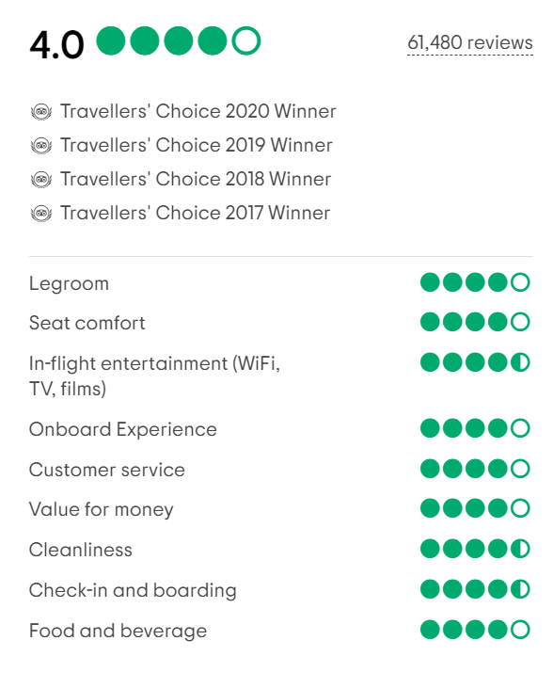
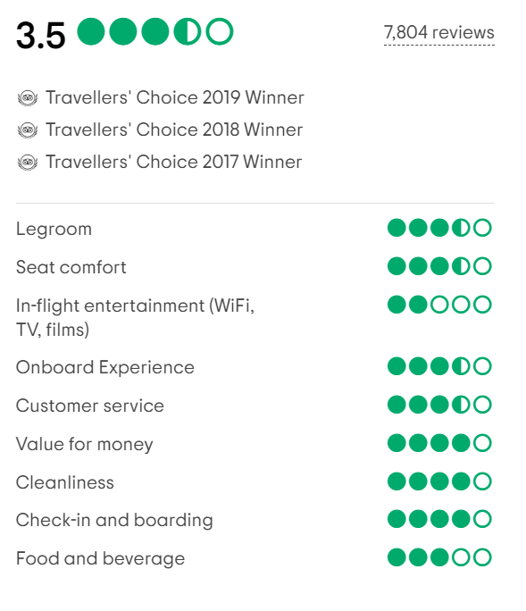
Indigo Emirates
Notes:
https://www.tripadvisor.in/Airline_Review-d8729090-Reviews-IndiGo

Slide 18
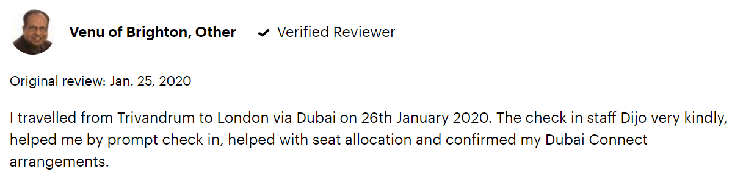
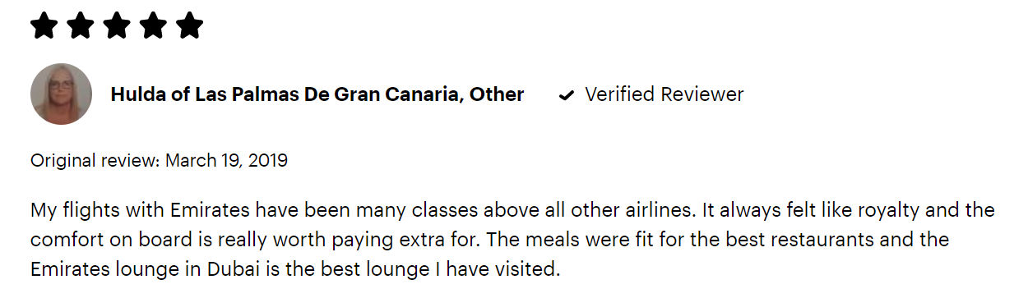
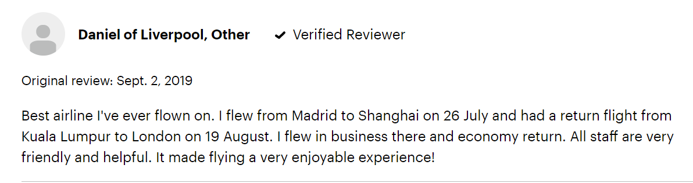
Glimpse of some reviews for Emirates
Notes:
https://emirates.knoji.com/
https://www.consumeraffairs.com/travel/emirates.html?#sort=top_reviews&filter=5

Slide 19
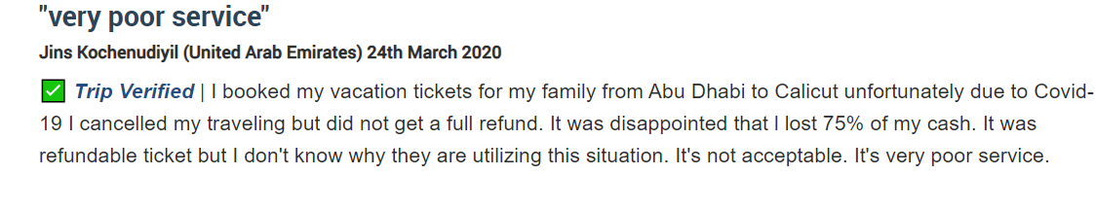
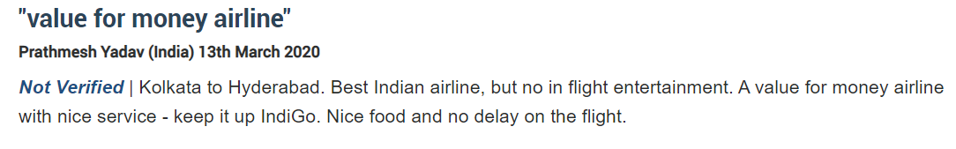
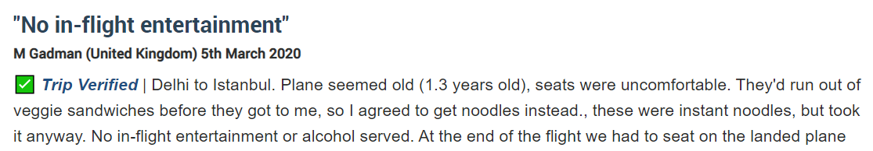
Glimpse of some reviews for Indigo

Slide 20
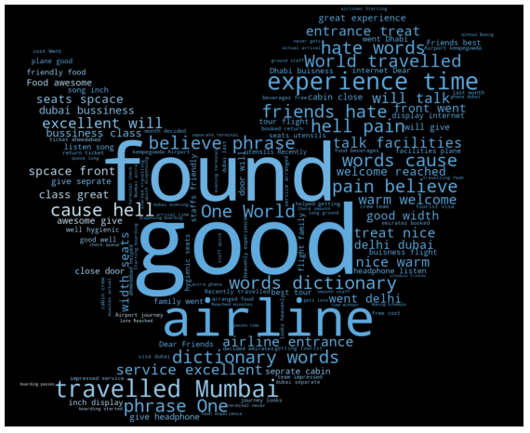
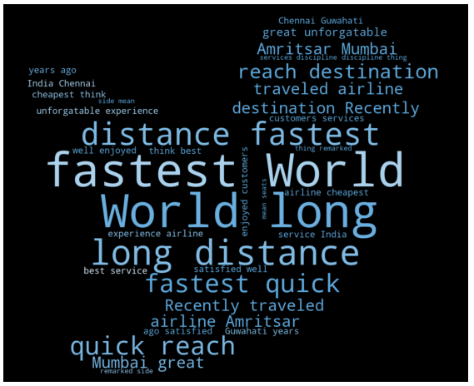
Word cloud of positive reviews
Emirates
Indigo

Slide 21
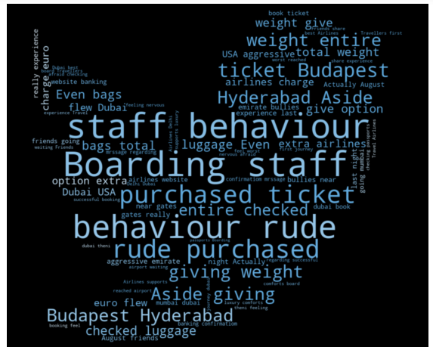
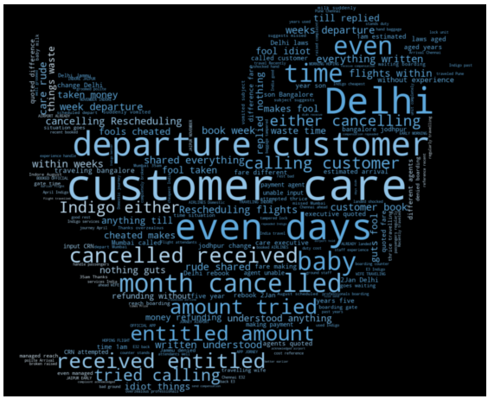
Word cloud of negative reviews
Emirates
Indigo

Slide 22
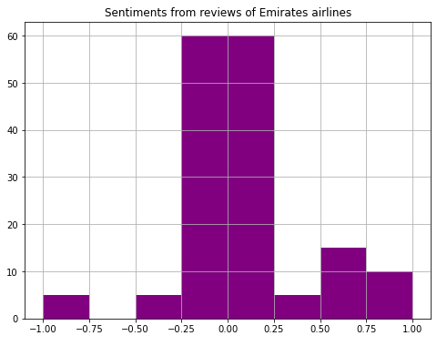
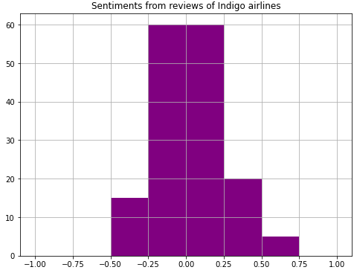
Sentiment Analysis

Slide 23
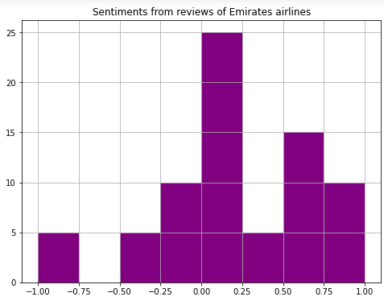
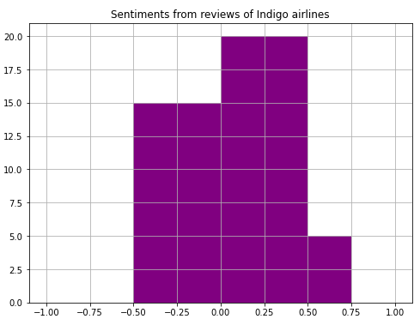
Sentiment Analysis

Slide 24
Conclusions
Companies that excel at customer experience grow revenues 4-8% above their competition
Superior experience earn stronger loyalty, turning customers into promoters with lifetime value 6 to 14 times that of detractors.
Voice of customer programs result in up to 55% greater client retention

Slide 25
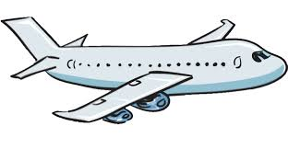

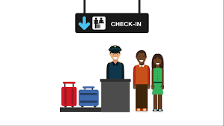

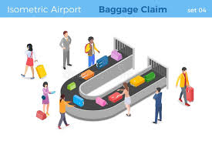

Customer journey mapping
Pre Airport
Airport
In flight
Post flight
In car driving to airport
Ticket check-in at the airport
On the airplane
At home searching and ordering tickets
Luggage check-in at the airport
Luggage pickup at the destination
Emotions and touch points
Notes:
So we have shown the customer’s whole journey from pre airport till post flight .We considered emotional touchpoints for each stage

Slide 26
Identified the key touch points
Pre-airport
Airport
In flight
Post-flight
Promotion notification
Travel planning
Reservations & booking
Ticketing
Flight delay notification
Virtual check-in and seat assignment
Transportation to airport and parking
Frequent flyer account management
Airport check-in and seat assignment
Baggage check
Security
Airport shopping or dining
Club room access
Airport waiting areas
Boarding pass and boarding
Gate location
Baggage storage
Entertainment
Meals
Shopping
Connectivity
Gate connections
Baggage claim information
Baggage pickup
Customer service and complaint management
Transportation from airport and parking
Frequent flyer account management
Notes:
In pre its very tedeous and tiring process so providing promotional notification,providing travel pannler app services like emirates,chauffer driver its not a comfortable experince to look for a drive with all your luggage,usage of FFP here also
Offers likeFast track baggage and check in process for customers,airport shopping like catalogue can be provided at airport also

Slide 27
Comparative analysis
Emirates: Emirates (emirates.com) is a very popular airline store which competes against brands like Southwest, American Airlines and Frontier Airlines. Emirates has an overall score of 4.7, based on 42 ratings on Knoji. Emirates' strengths are: Offers free cancellation policies Offers online check-in policies Offers free checked baggage policies Offers inflight meal services Offers pre-assigned seating policies. | Indigo: IndiGo Airlines (goindigo.in) is a very popular airline store which competes against brands Copa Holdings, Avianca, SAS (Scandinavian Airlines) and Norwegian Air Shuttle. IndiGo Airlines has an overall score of 4.5, based on 41 ratings on Knoji. Indigo’s strengths are: Offers online check-in policies Offers free checked baggage policies Offers inflight meal services Offers pre-assigned seating policies Accepts debit & prepaid card support
Notes:
https://www.livemint.com/companies/news/indigo-the-low-cost-conqueror-is-now-coming-for-emirates-etihad-airways-1559043187672.html
https://www.slideshare.net/KannanKnight/indigo-27252482

Slide 28
Emirates does offer inflight entertainment. Emirates does have wifi service Emirates does offer power outlets. As of January 23, 2018, Emirates was offering power outlet availability on their website. Emirates does offer affiliate programs Emirates does offer pet policy Emirates does offer partner airlines Emirate have Frequent flyer program:Skyward | IndiGo Airlines does not offer inflight entertainment. IndiGo Airlines does not offer inflight wifi. IndiGo Airlines does not offer power outlets IndiGo Airlines does not offer affiliate programs IndiGo Airlines does not offer pet policy. IndiGo Airlines doesn't have wide range of partner airlines at the current time. Frequent flyer program:No
Notes:
https://knoji.com/compare/emirates-vs-indigoairlines/

Slide 29
Gaps
No frequent flyer program.
Lack of integrated marketing communication: The advertising and promotional activities of the Indigo airlines is very low due to which there is the problem that customers are not aware about scheme and discount on flights.
Absence of customer driven standard: In the ‘economy class’ there is problem that Indigo airlines is not able to provide customers driven standard and quality of service to the customers. In Indigo airlines the cabin crew is often takes a lot of time to tend to the passengers which we found to be a frequent complaint. There are also a lot of delays and cancellations which are sometimes not conveyed prior to the passengers.
Less number of alliances with other airlines

Slide 30
Overcome gaps
Customer driven standard: The Indigo should inculcate 360 degree feedback facility on all major touchpoints. On the basis of complaint management can take appropriate action and give warnings to staff to avoid unethical behaviour. This implementation can enable them to meet the customer driven standard .
Integrated marketing communication: Indigo airlines should start promotional marketing through social media such as Instagram,Facebook,etc.
Code-Sharing Partnerships: Indigo should have more codeshare agreements.It save customer’s time and money by giving access to a wider net of travel-related items and experiences. Currently Indigo have Code Sharing partnership with 2 airlines only(Turkish Airlines and Qatar Airways)
Notes:
A code share flight is a flight that is marketed by one carrier and operated by another. Code share flights come about as a result of agreements between airlines to sell seats on each others' flights in order to provide passengers with a wider choice of destinations.
It allows airlines to offer flights to destinations they don't actually serve. It also helps with customer loyalty. For passengers racking up miles in attempts to earn frequent flier status, code-sharing makes it possible to earn points on a route your airline doesn't presently offer.
Code sharing is a marketing arrangement in which an airline places its designator code on a flight operated by another airline, and sells tickets for that flight. Airlines throughout the world continue to form code-share arrangements to strengthen or expand their market presence and competitive ability.

Slide 31
Recommendations
Loyalty Programs - Indigo does not have any frequent flyer program. Indigo must come out with a program for frequent flyers so as to attain their loyalty.Provide Loyalty Cards to those customers who prefer IndiGo airlines for their journey most of the time. For every journey they make some points can be added to their card and the next time they book a ticket they can be provided with some discount.High-value customers should be provided with special treatment according to their status. Eg. miles-based frequent flyer programs, value based frequent flyer programs.
Mile-Based FFP - Based on the actual miles traveled, beneficial for discounted fare, long distance and price sensitive customer
Value Based FFP - Miles are earned by amount spent by a member. Beneficial for premium fare, last-minute and business class members
Inflight wifi and entertainment services to enhance customer experience. This can be a paid facility as the fare charges are comparatively low.

Slide 32
Loyalty Program for Indigo
Indigo Club - When you fly with us, we ensure you are rewarded by the most unique and fastest rewarding frequent flyer program in the Indian skies.Earn CV Points to redeem for Award Flights, Upgrade Awards, and a host of privileges.
Benefits- Faster Points Accrual, Easy Redemptions, Airline Partners, Attractive Lifestyle Partners.
Indigo Club Tiers - Fly with Indigo and enjoy the benefits of Base, Silver, Gold or Platinum tier. As you move to higher tiers, you enjoy exclusive benefits and special privileges for an unparalleled flying experience.
Notes:
In a miles-based program, your earnings are calculated based on the distance travelled. However, in a value-based program, your points are calculated based on the value of the fare purchased by you. When tickets prices fluctuate you may end up spending more, but you will earn more too.

Slide 33
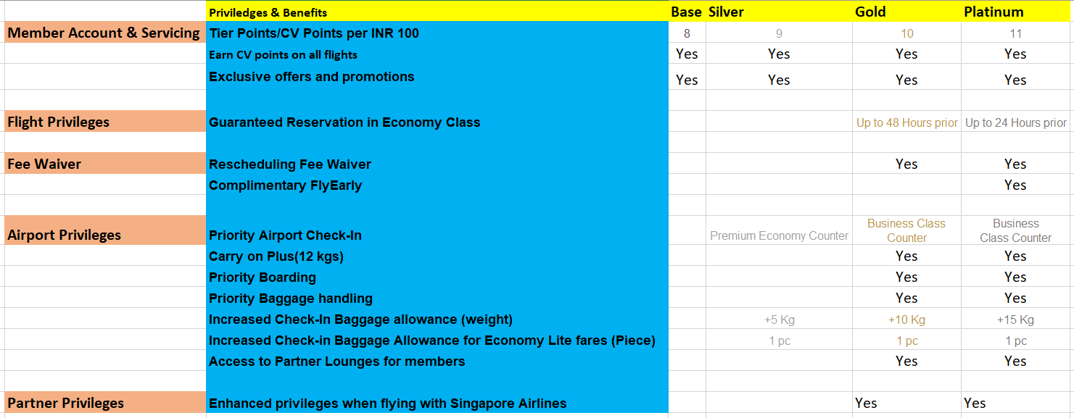
Proposed Model

Slide 34
Contd.
Free Food Scheme: Identify those people who frequently use Indigo Airlines for their journey and provide them with free on board food after particular no. of trips.
Additional Discounts - If the person prefers indigo for their single trips to different places then he can be provided with some discounts on the ticket of his family if they are planning some trip.
Self service initiatives: Increase self service initiatives in Indigo airlines. Which can help to reduce customer service costs immediately with a relatively low implementation cost, this is applicable on low value customers. Making customers aware about different activities and providing them options to choose particular service, eg. self-check in.

Slide 35
Thank You

